Slide 1
Title: An investigation of flavanoid diversity in Scutellaria to identify species with medicinal potential
Authors: Bryce Askey, Yeong Hun Song, Yoonkyung Lee, Ru Dai, Sangtae Kim, and Jeongim Kim
Scutellaria baicalensis is a medicinal plant whose root extracts have been widely used in Asian medicine for more than 2,000 years. Flavonoids in these extracts possess anti-cancer, antioxidant, antiviral, and neuro-psychologic properties. Because of interest in the medicinal properties of these flavonoids, the reference genome of S. baicalensis has been recently completed. Although S. baicalensis has been well-studied, the majority of the 470 species in the genus have not been analyzed. This study aims to extend the current knowledge of Scutellaria by analyzing flavonoid profiles and genome sizes of a large set of species representing the diversity in the genus. Targeted metabolite analysis of fresh and dried samples was completed with High Performance Liquid Chromatography (HPLC) to quantify 15 flavones. The genome sizes of eight of the species analyzed were also estimated with flow cytometry. A comparison of phytochemical profiles indicate diversity in site and identity of accumulation for multiple species when compared to S. baicalensis. Inconsistences in site of accumulation between the proposed flavonoid biosynthesis pathway for S. baicalensis and chemical analysis results imply significant differences in the pathway for several species. Flow cytometry results revealed 7 of the 8 species analyzed have similarly sized genomes as S. baicalensis and should be considered for further study. Researchers studying Scutellaria can use the results of this work to identify previously uncharacterized species with medicinal potential. A better understanding of phytochemical diversity in Scutellaria will aid in the development of new drugs and treatments from the extracts of the plant.

Slide 2
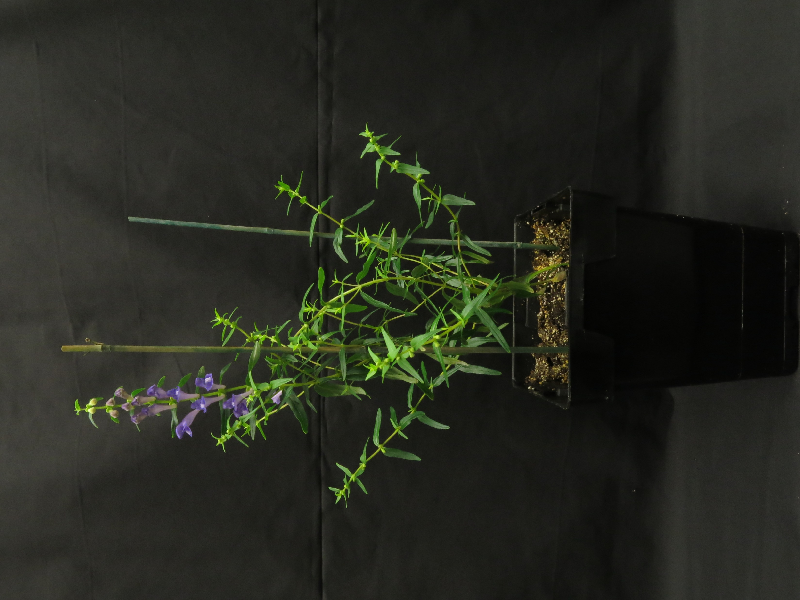
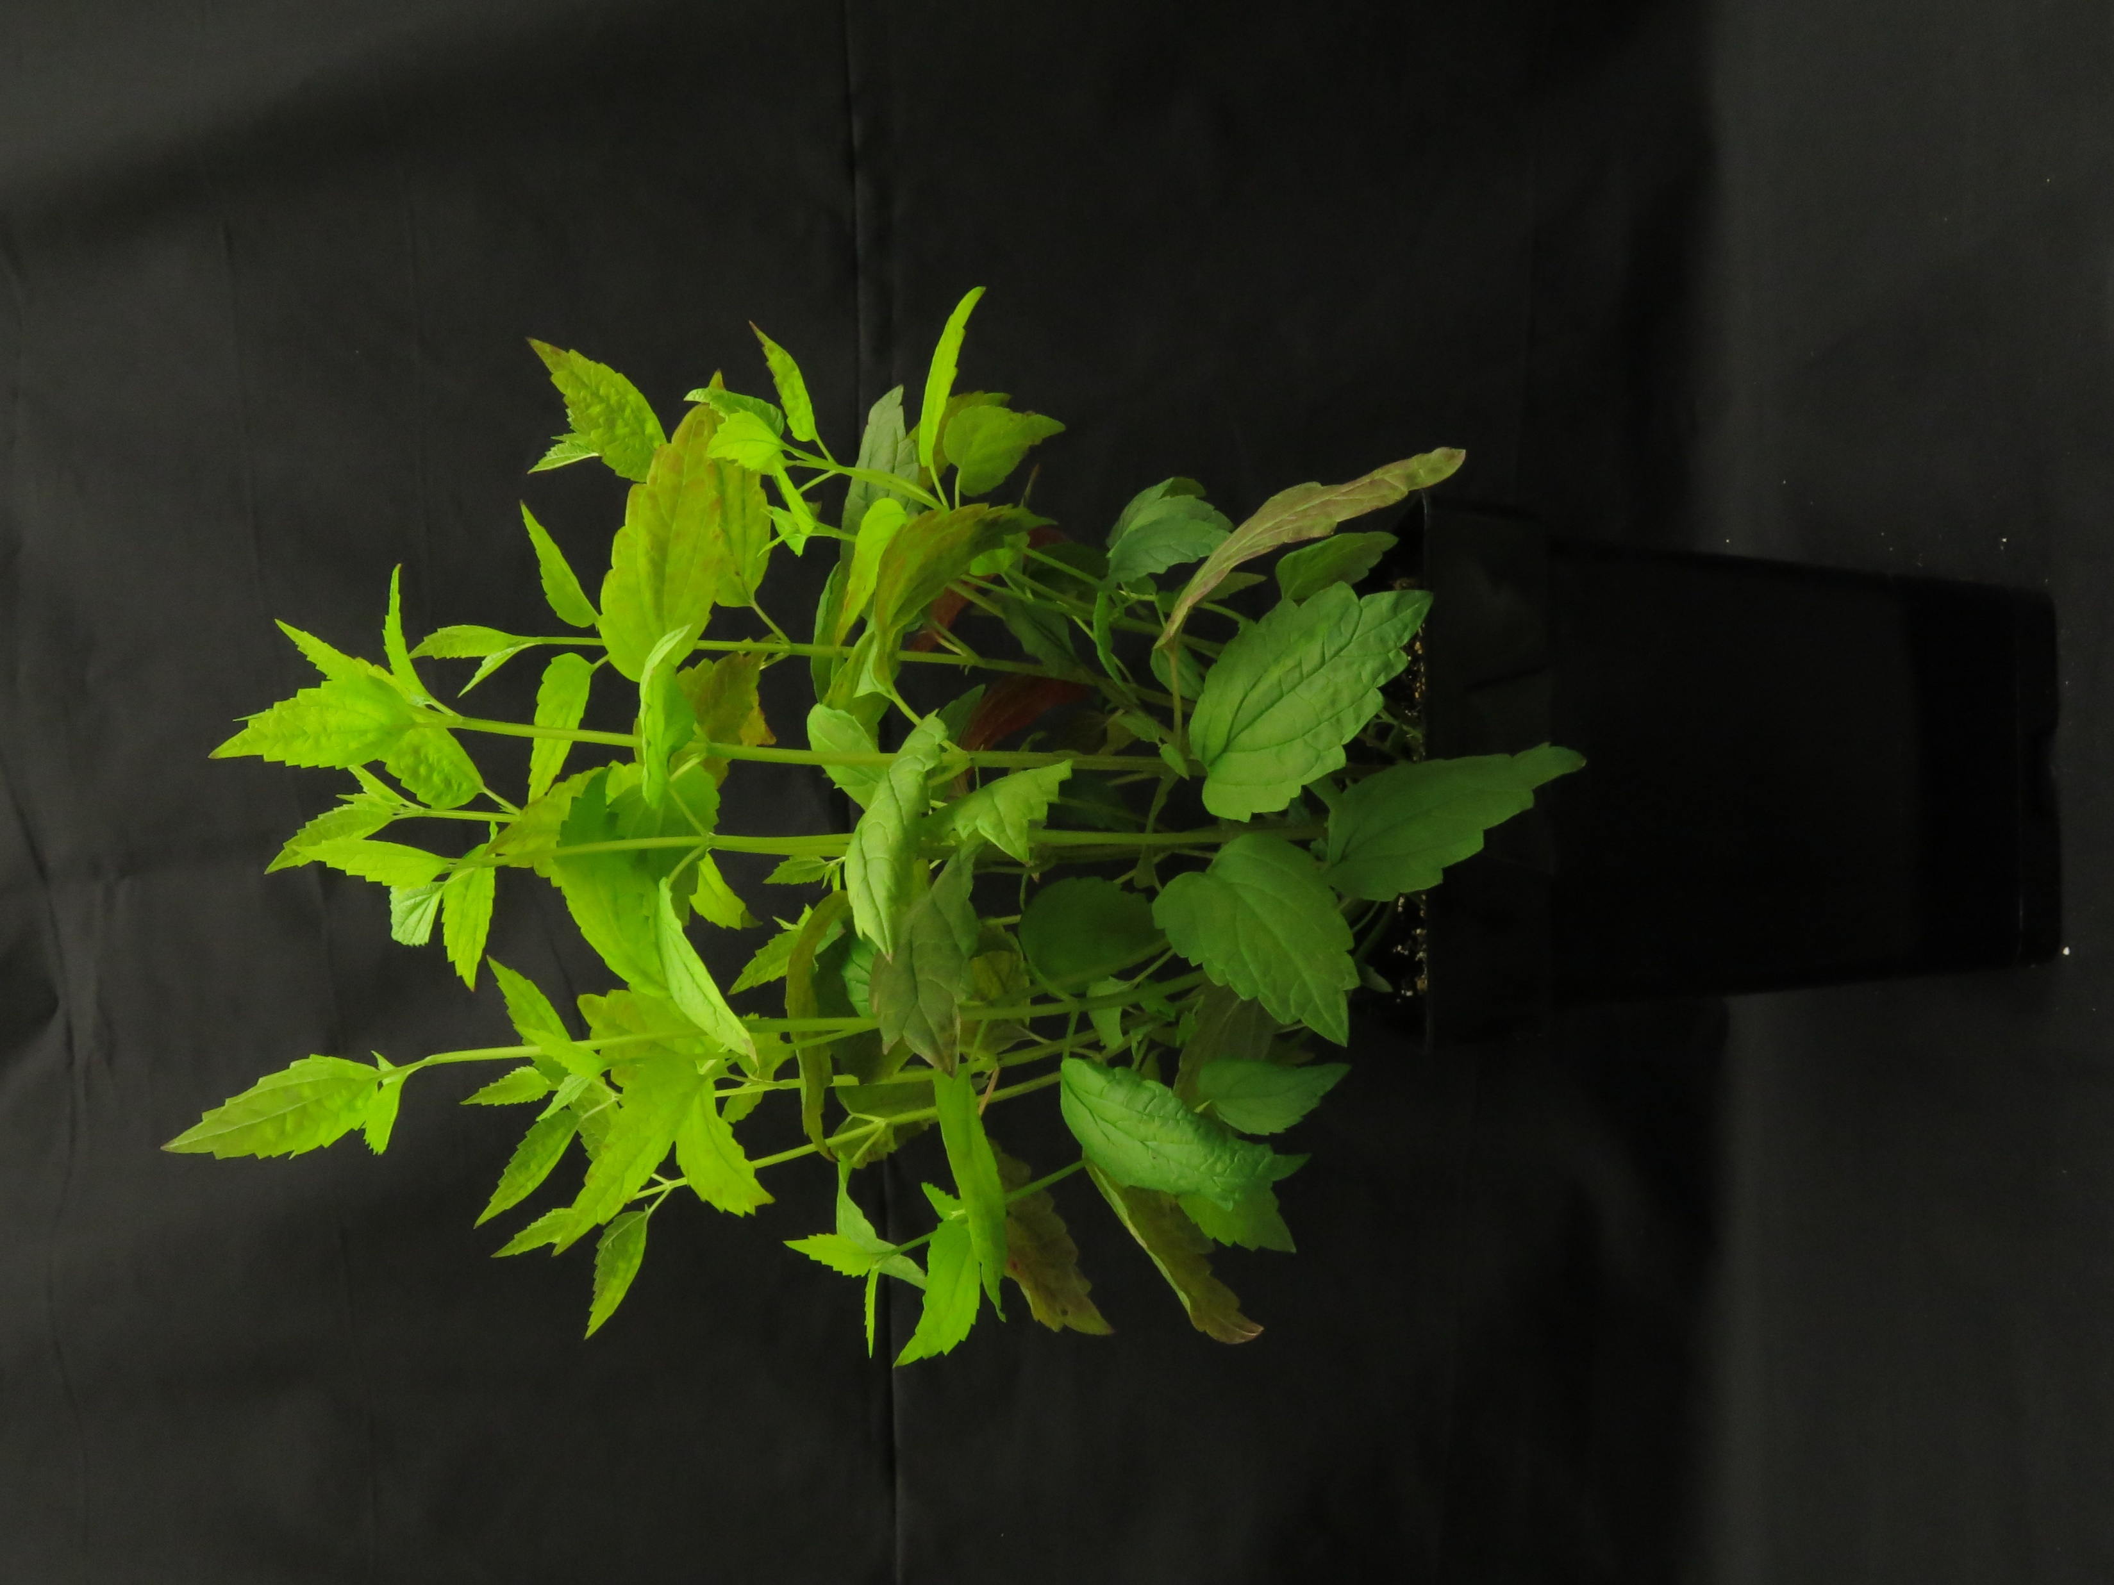
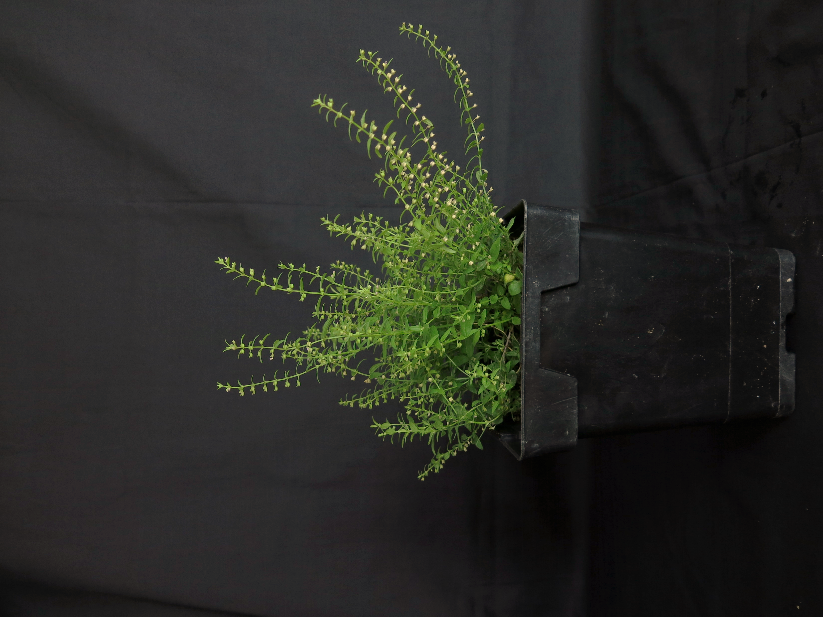
A
B
C
Figure 1. Images of (A) S. baicalensis, (B) S. lateriflora, and (C) S. racemosa plants.

Slide 3
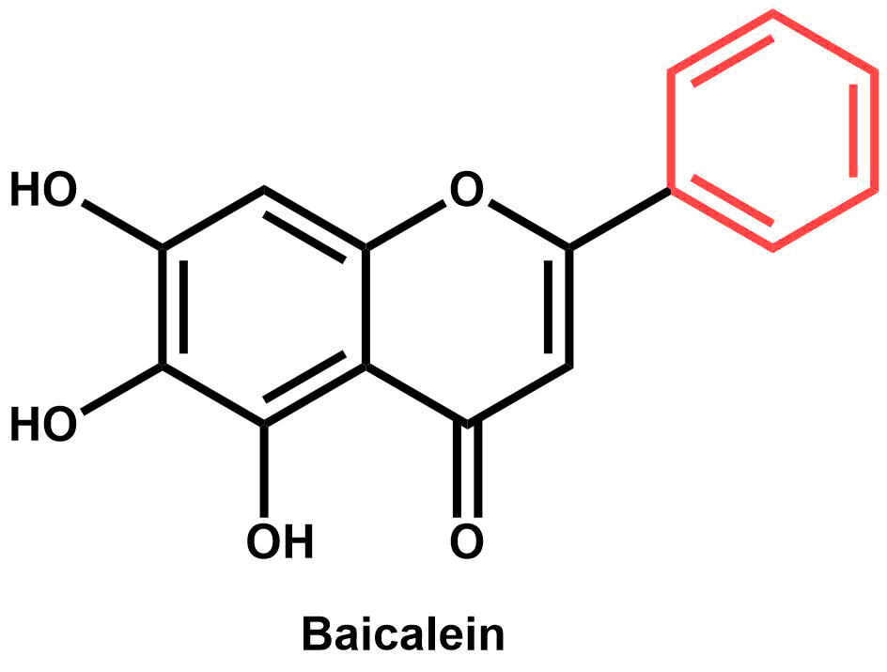
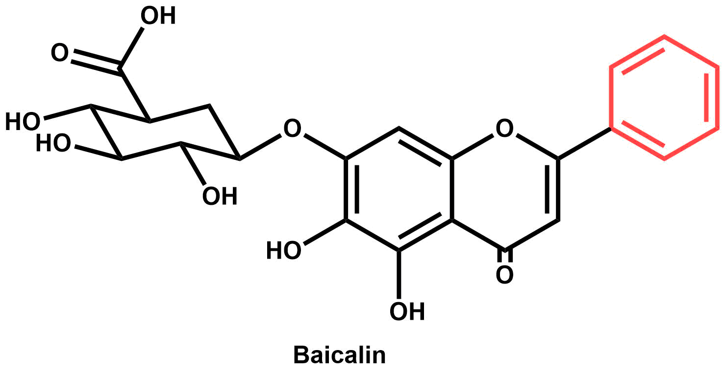
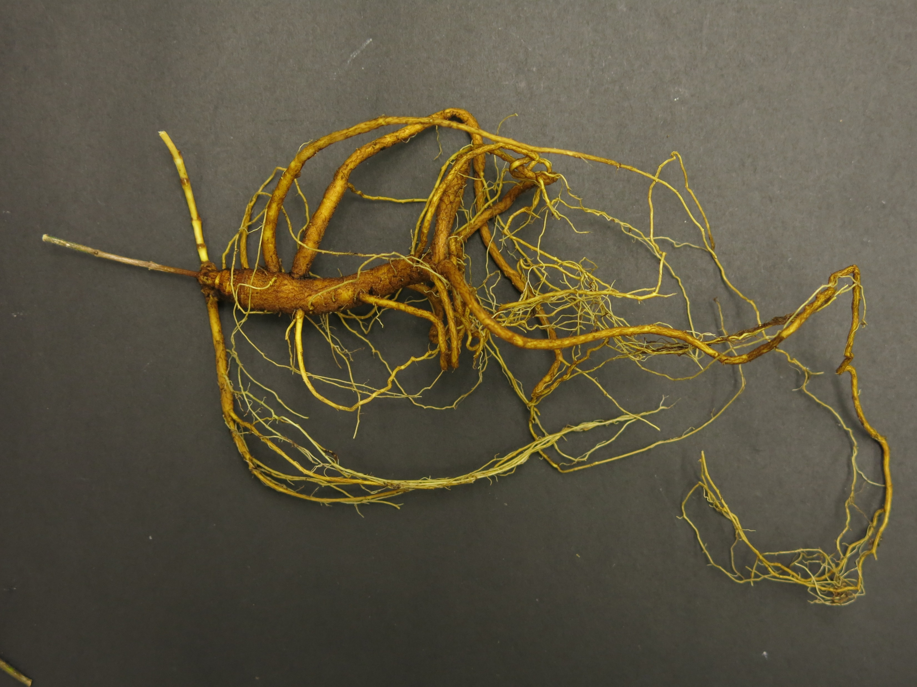
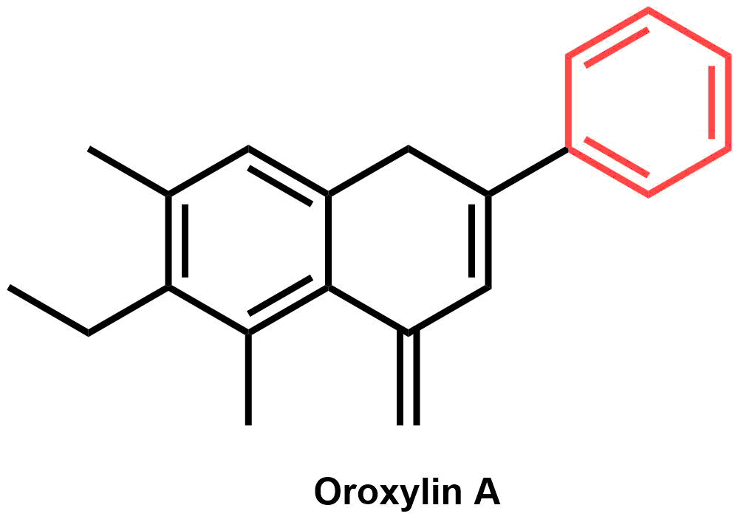
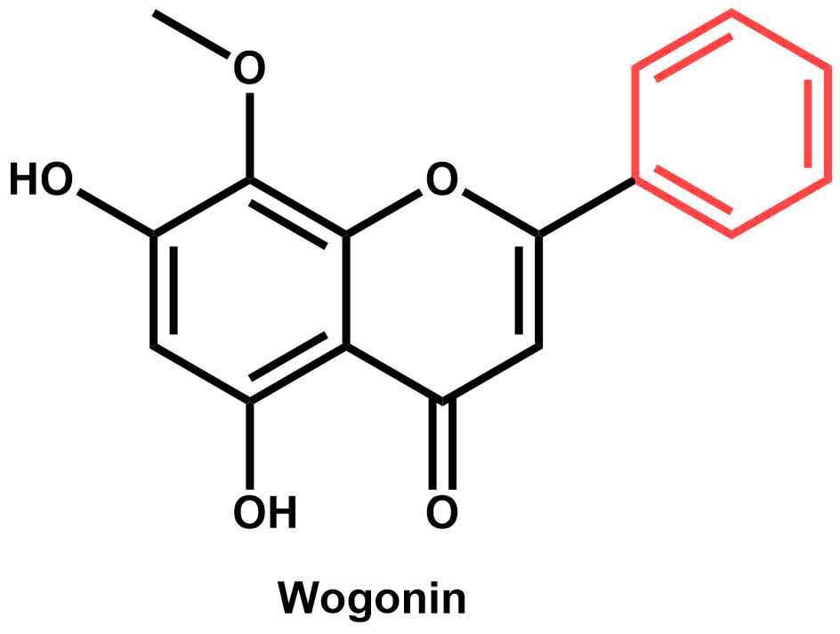
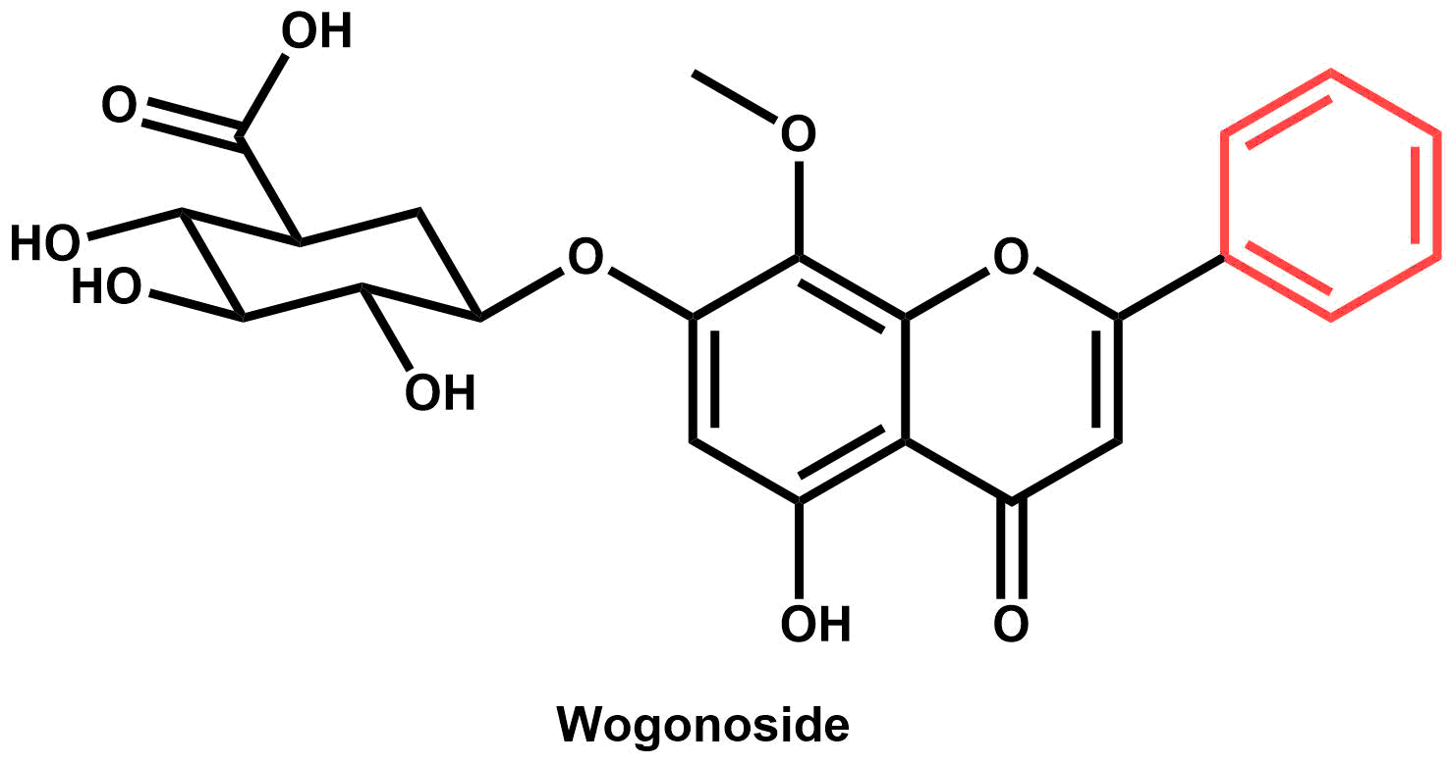
Baicalein:
anti-Alzheimer’s and anxiolytic activity (Shang et al., 2005; Gasiorowski et al., 2011; Awad et al., 2003; Cole et al., 2007)
Baicalin:
anti-cancer and anxiolytic activity (Zhao et al., 2016;
Awad et al., 2003; Cole et al., 2007)
Oroxylin A:
anti-Alzheimer’s activity (Shang et al., 2005; Gasiorowski et al., 2011)
Wogonin:
anti-cancer and anti-Alzheimer’s activity (Zhao et al., 2016; Cole et al., 2007
Wogonoside:
anti-cancer activity (Zhao et al., 2016)
Figure 2. S. baicalensis root extracts contain a variety of metabolites with medicinal properties.

Slide 4
Aerial
Root
Figure 3. Proposed pathway for S. baicalensis illustrates organ-specific metabolite accumulation.

Slide 5
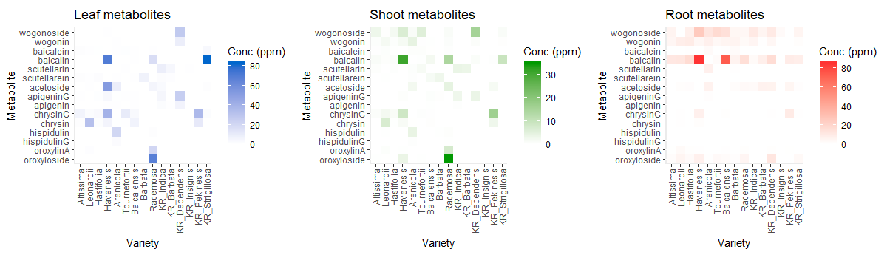
Figure 4. Heatmaps of organ-specific metabolite accumulation across 14 species of Scutellaria for 15 metabolites analyzed.

Slide 6
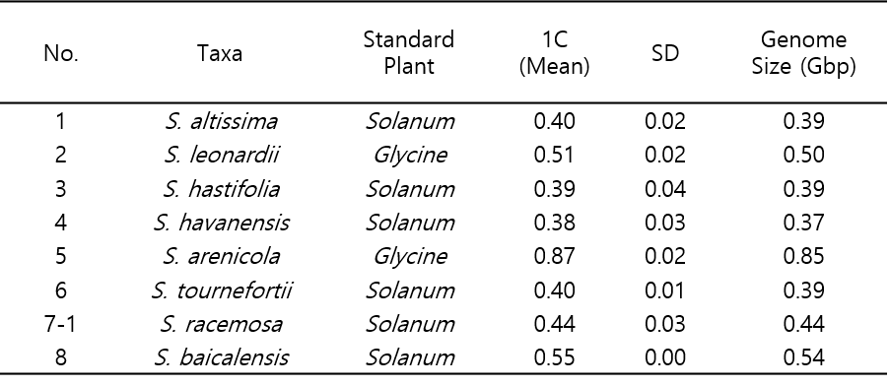
Table 1. Genome sizes for species of interest

Slide 7
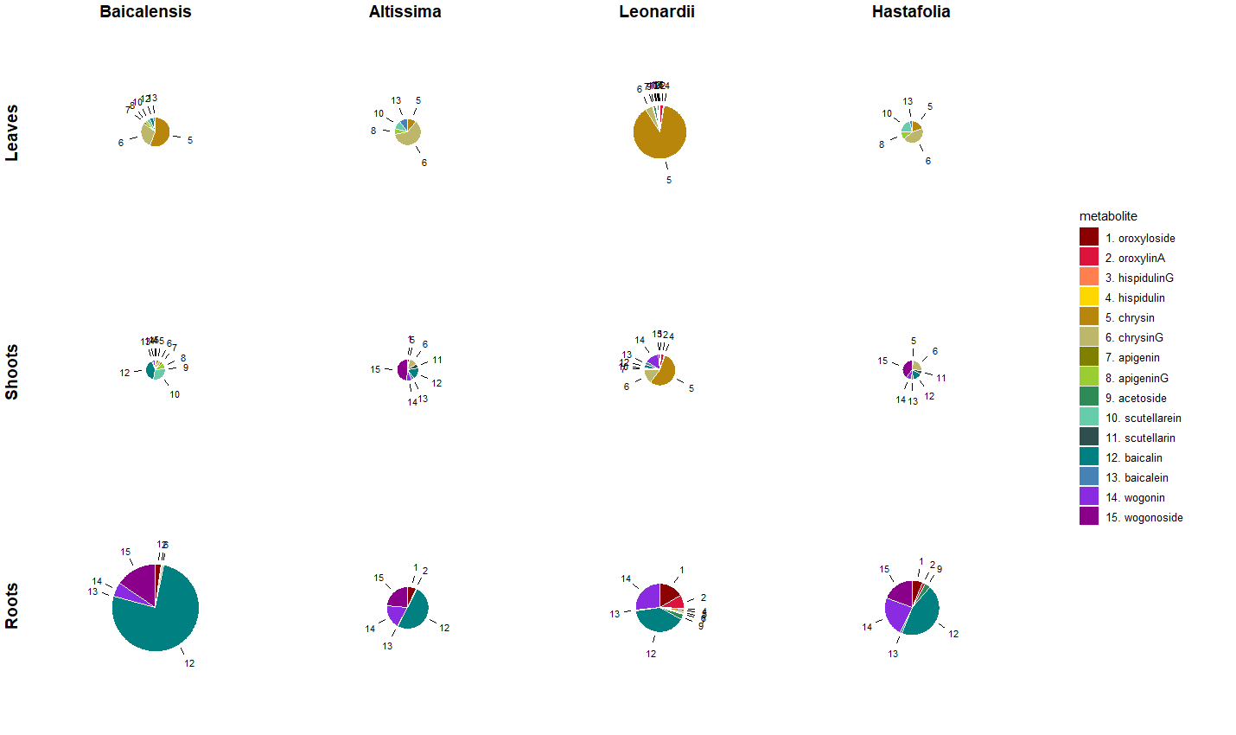
Figure 5. Scaled pie charts for species of interest

Slide 8
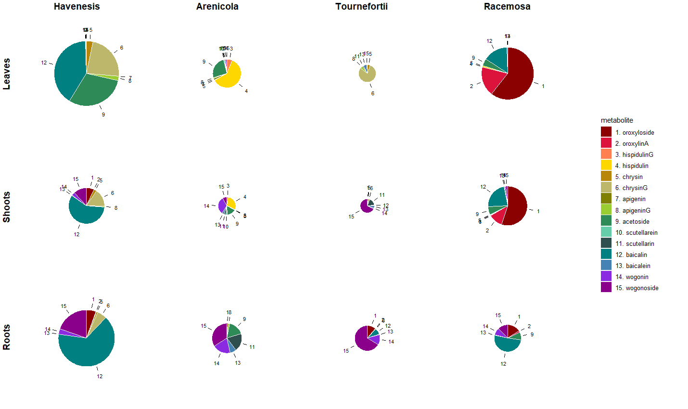
Figure 5. Scaled pie charts for species of interest

Slide 9
Figure 6. Revised metabolite pathway.

